Slide 1
Module 2.3 Data Visualization

Slide 2
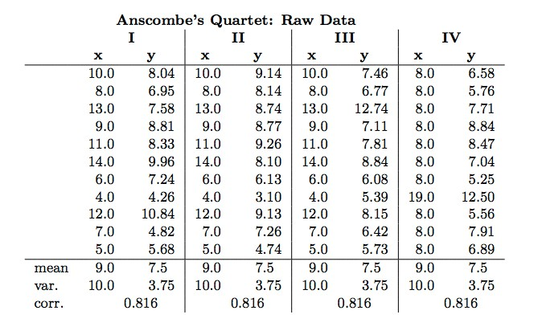
Anscombe’s Quartet
Same mean, variance, correlation, and linear regression line
Anscombe ’73

Slide 3
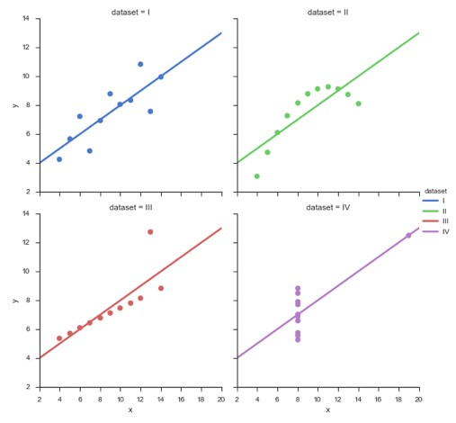
Anscombe’s Quartet
Same mean, variance, correlation, and linear regression line
http://web.stanford.edu/~mwaskom/software/seaborn/examples/anscombes_quartet.html
Anscombe ’73

Slide 4

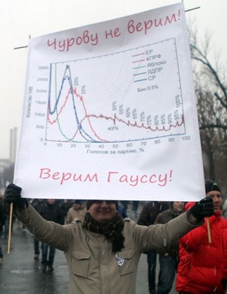
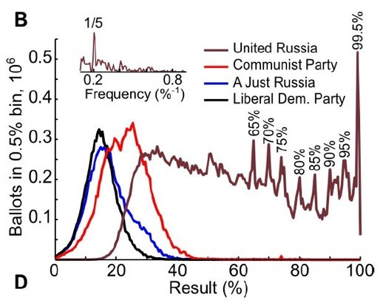
Normal Distribution
Example: Russian President Elections
“We do not trust Churov [the head of the committee]!
We trust Gauss”
Image from http://nl.livejournal.com/1082778.html

Slide 5
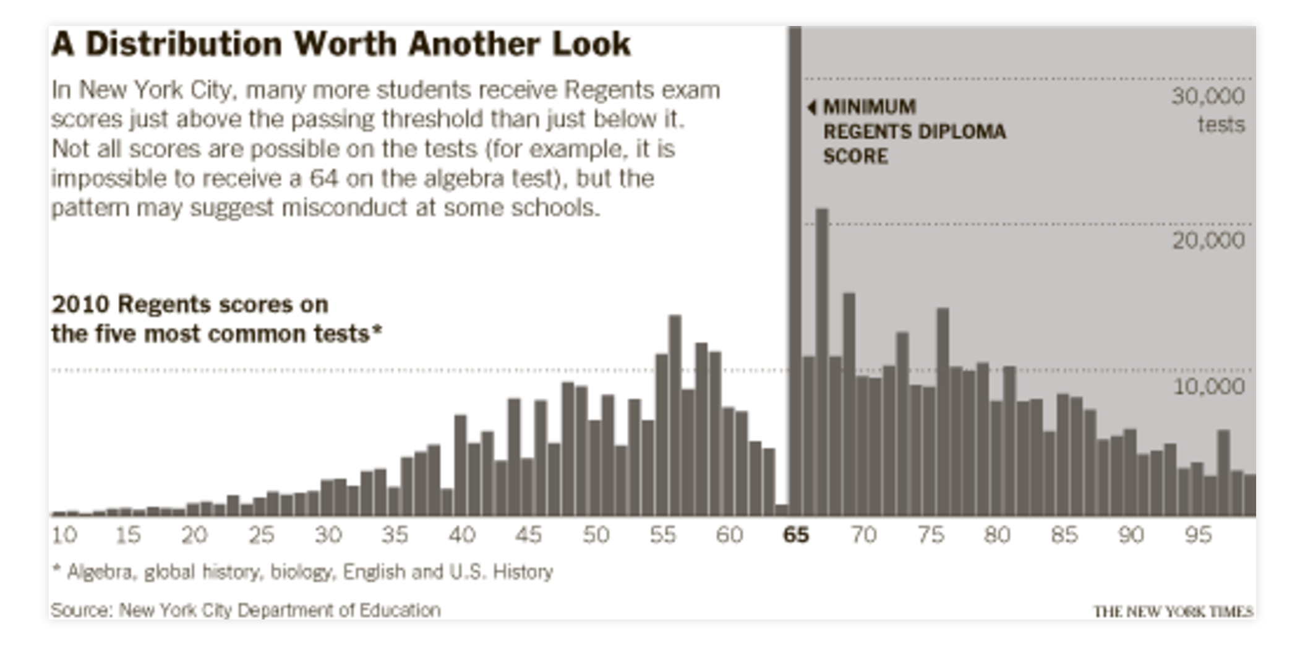
Grades from NYC Regents Exam

Slide 6
Across U.S. Companies, Tax Rates Vary Greatly
https://archive.nytimes.com/www.nytimes.com/interactive/2013/05/25/sunday-review/corporate-taxes.html

Slide 7
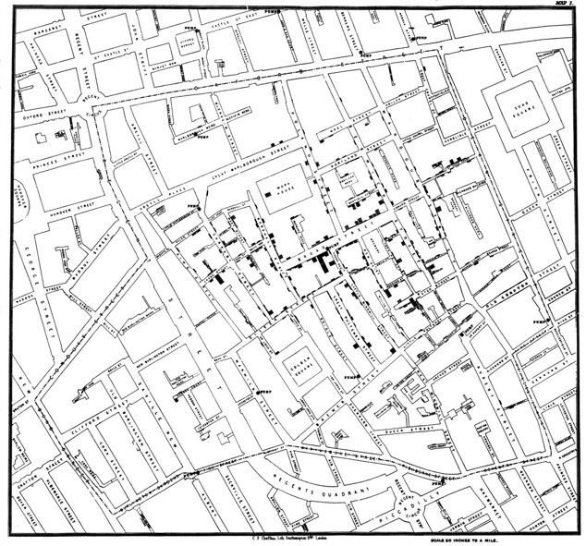
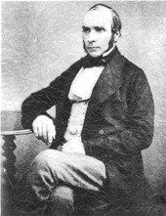

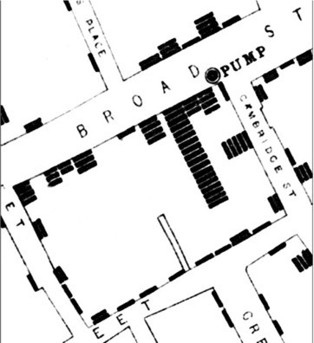
Detect the expected – discover the unexpected
John Snow (1813 – 1858)
Wikimedia Commons

Slide 8
Visualization Goals
Presentation
Known facts about data Task: Communicate results
Exploration
Data without hypothesis Task: Generate hypothesis
Confirmation
Hypothesis is given
Task: Verify / falsify hypothesis

Slide 9
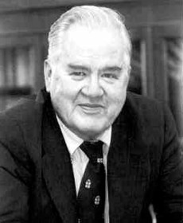
Exploratory Data Analysis (EDA)
“The greatest value of a picture is when it forces us to notice what we never expected to see.”
-John Tukey (1915 - 2000)

Slide 10
EDA Definition
An approach of analyzing data to summarize their main characteristics without using a statistical model or having formulated a prior hypothesis.
Exploratory data analysis was promoted by John Tukey to encourage statisticians to visually examine their datasets, to formulate hypotheses that could be tested on new datasets. [wikipedia]

Slide 11
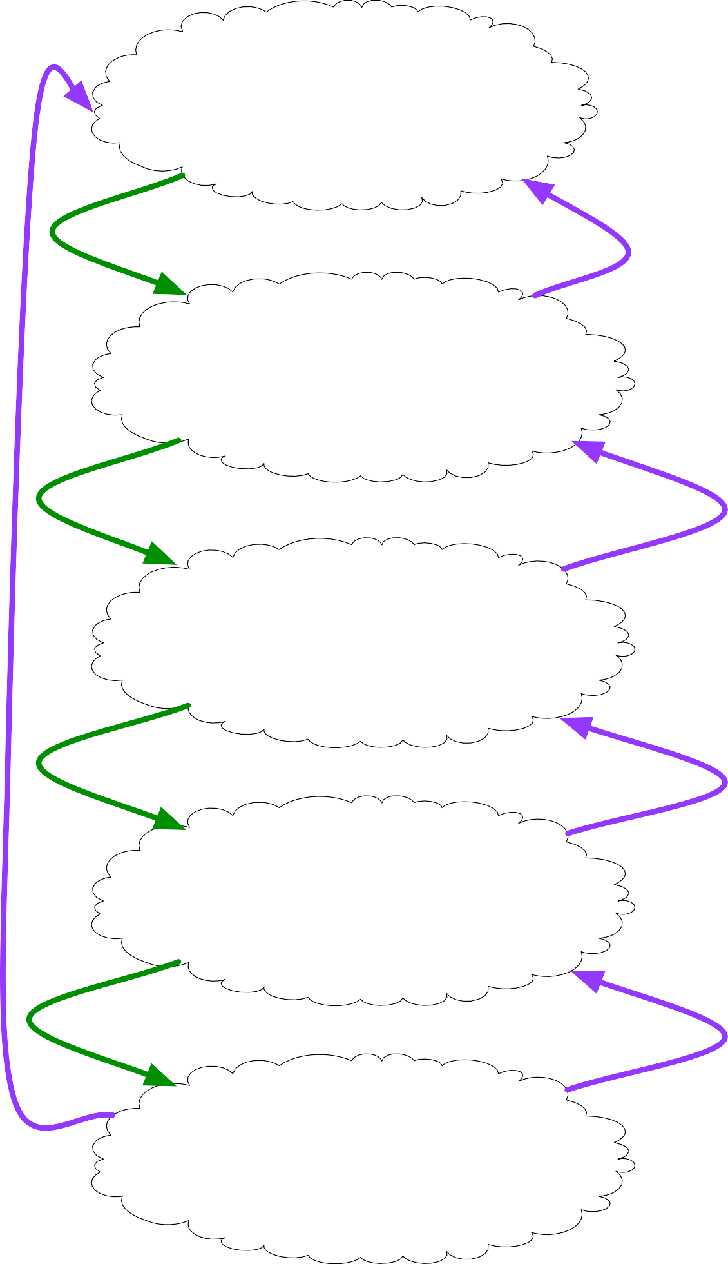
Ask an interesting question.
What is the scientific goal?
What would you do if you had all the data? What do you want to predict or estimate?
How were the data sampled?
Which data are relevant? Are there privacy issues?
Get the data.
Plot the data.
Are there anomalies? Are there patterns?
Explore the data.
Model the data.
Build a model.
Fit the model.
Validate the model.
Communicate and visualize the results.
What did we learn?
Do the results make sense?
Can we tell a story?

Slide 12
Data Dimensions

Slide 13
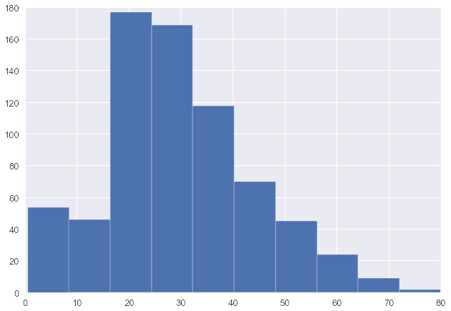
Univariate Data
# of passengers
age

Slide 14
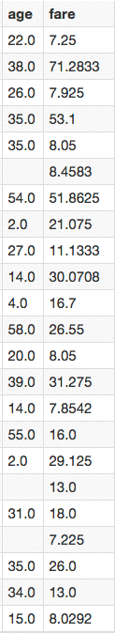
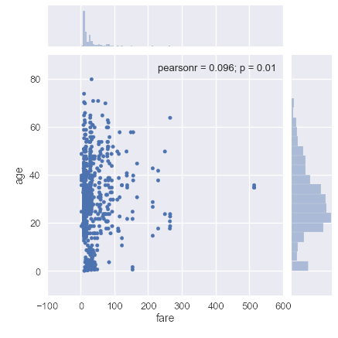
Bivariate Data

Slide 15
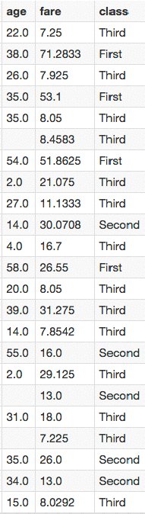
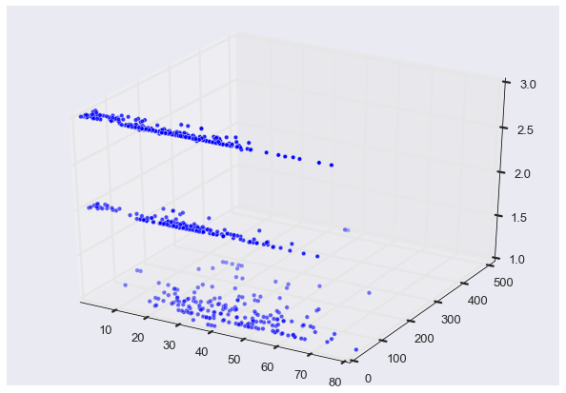
Trivariate Data
class
fare
age
Do NOT use 3D scatterplots!

Slide 16
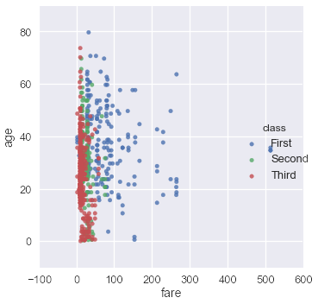
Trivariate Data
Map the third dimension to some other visual attribute

Slide 17
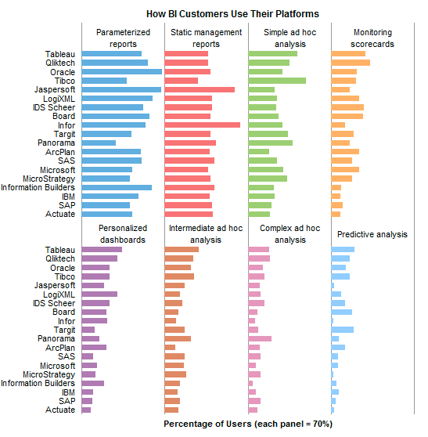
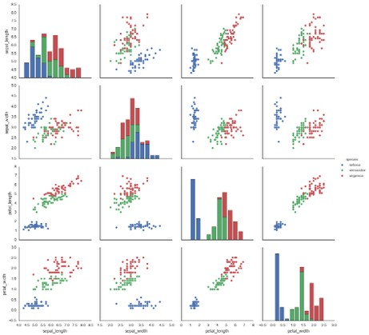
Multivariate Data
Give each attribute its own display (small multiples)

Slide 18
Data Reduction
Filtering:
Eliminate some items or attributes
e.g., select range of interest, zoom in, remove outliers, etc.
Aggregation: Represent a group of elements by a new derived element
e.g., take average, min, max, count, sum
Attribute aggregation a.k.a. dimensionality reduction

Slide 19
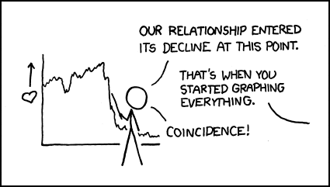
Statistical Graph Types
http://xkcd.com/523/

Slide 20
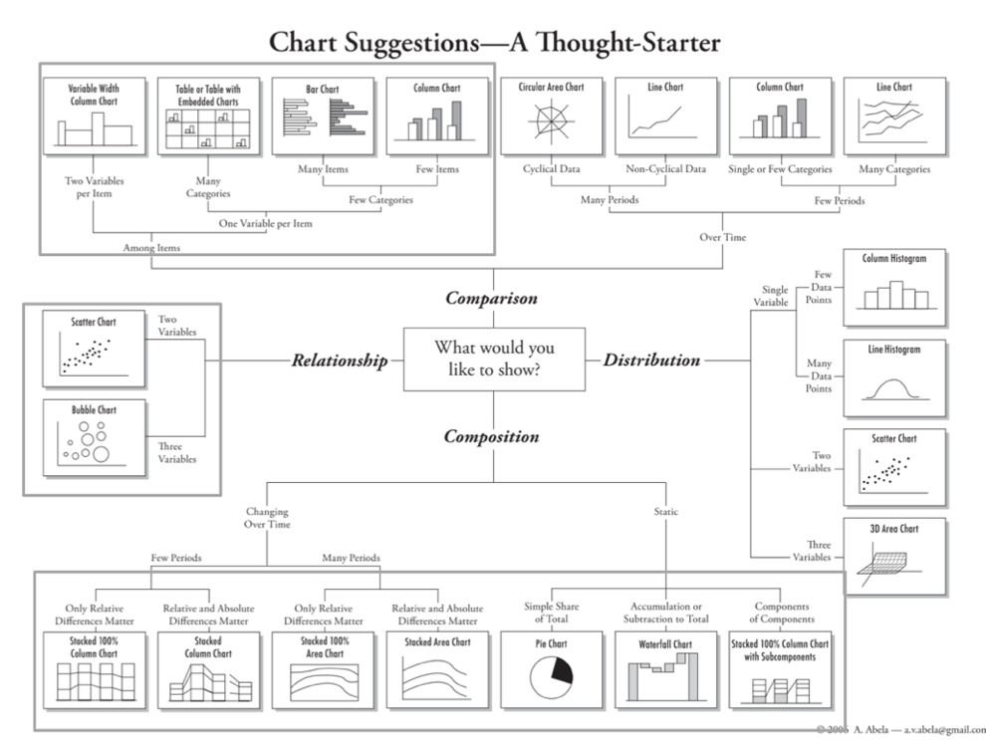
http://extremepresentation.typepad.com/blog/files/choosing_a_good_chart.pdf

Slide 21
Comparisons

Slide 22
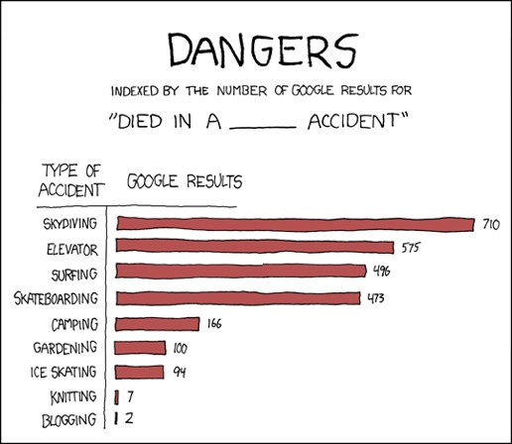
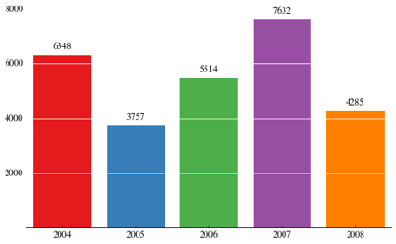
Bar Chart
http://nbviewer.ipython.org/gist/olgabot/5357268

Slide 23
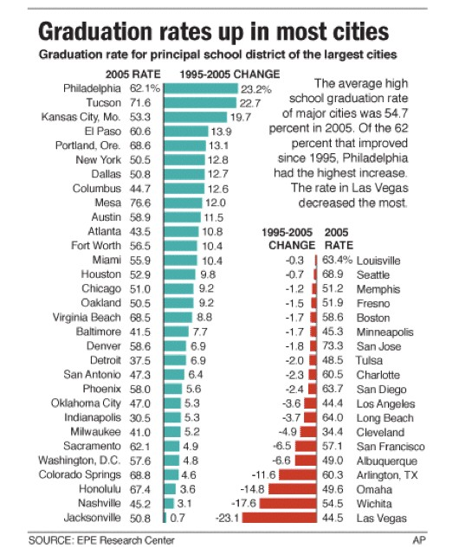
Direction
Nicolas Rapp

Slide 24
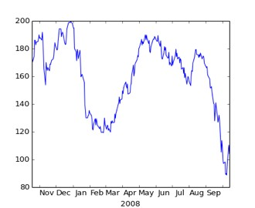
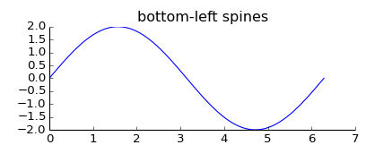
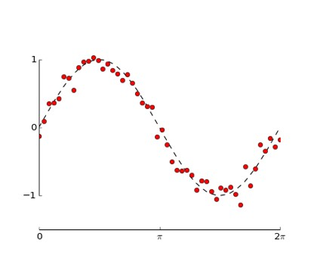
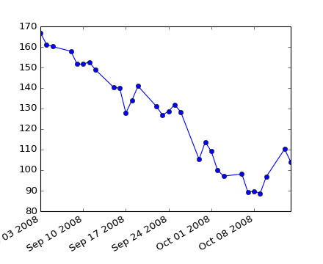
Line Charts
matplotlib gallery

Slide 25
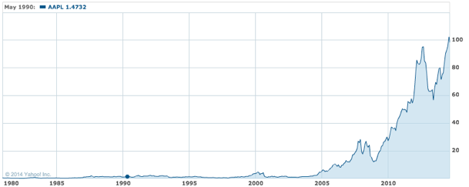
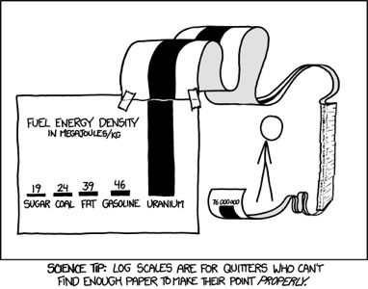
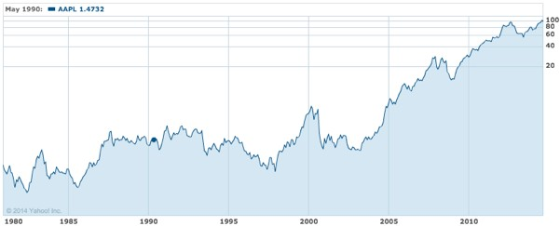
Linear vs. Logarithmic Scale
Linear Scale
Log Scale
http://xkcd.com/1162/
Apple Stock Price
http://finance.yahoo.com/echarts?s=AAPL

Slide 26
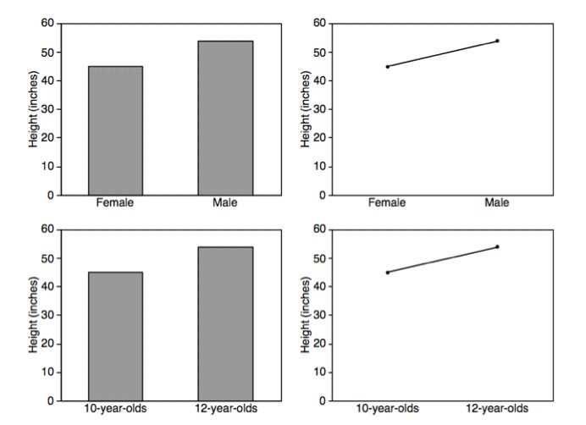
Bars vs. Lines
Lines imply connections - do not use for categorical data
Zacks 1999

Slide 27
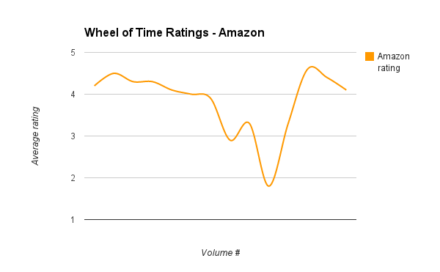
Don’t
Use bar charts to compare book ratings
“Visualizing The Wheel of Time: Reader Sentiment for an Epic Fantasy Series”, J. Siddle, Sept 2013

Slide 28
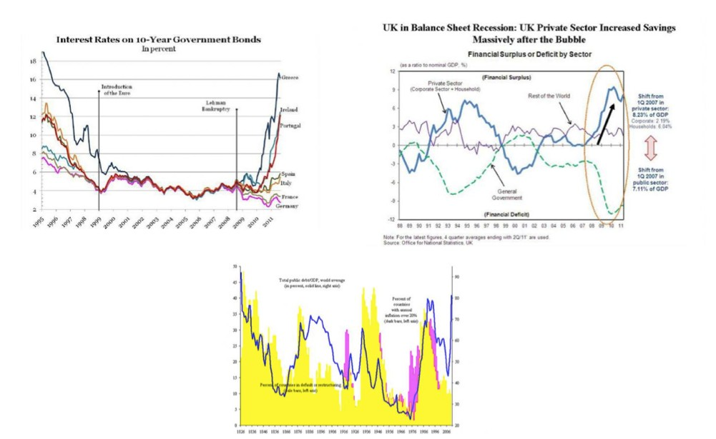
Don’t

Slide 29
Correlations

Slide 30
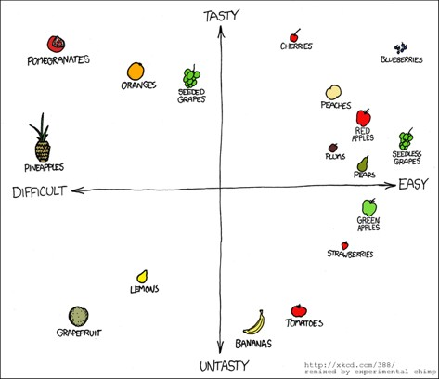
Scatterplots

Slide 31
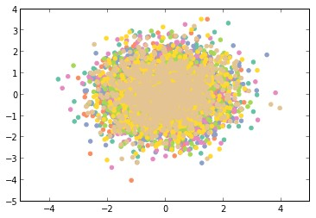
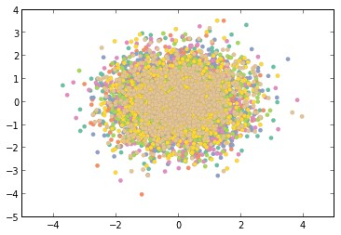
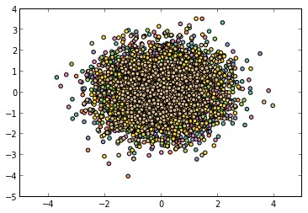
Scatterplots
Black Border
No Border
Light Grey Border
http://nbviewer.ipython.org/5357268

Slide 32
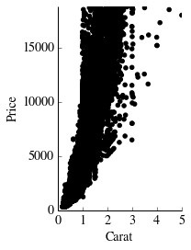
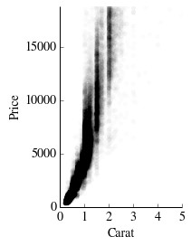
Overplotting
alpha = 1/100

Slide 33
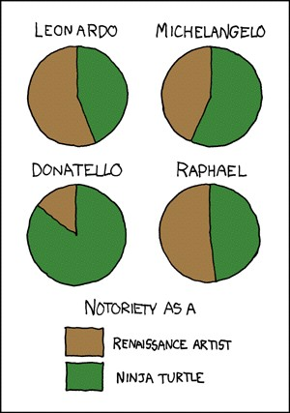
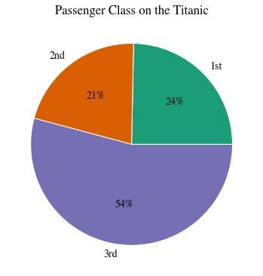
Pie Charts
http://xkcd.com/197/

Slide 34
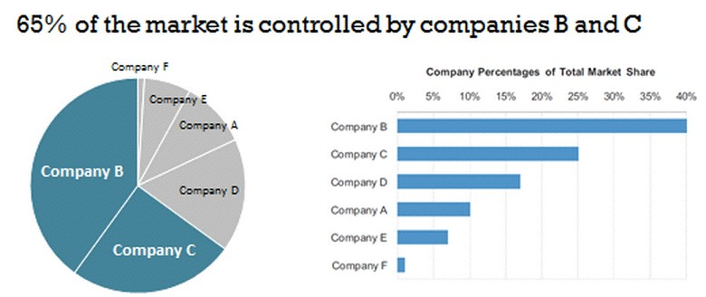
Pie vs. Bar Charts

Slide 35
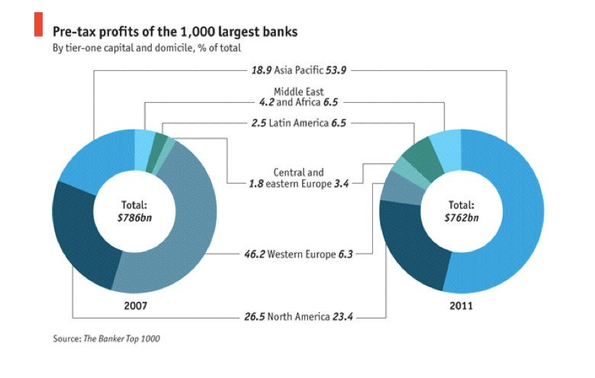
Donut Chart
The Economist Daily Chart

Slide 36
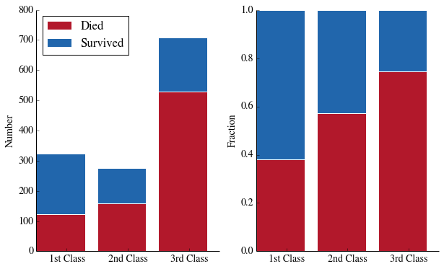
Stacked Bar Chart

Slide 37
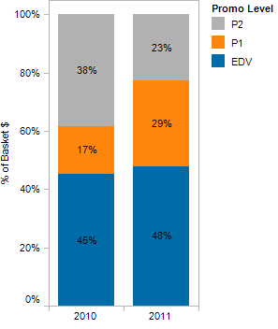
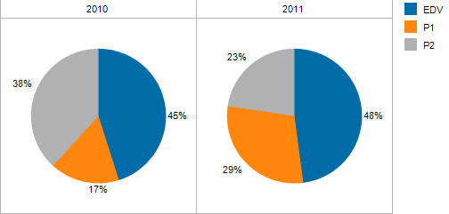
Stacked Bar Chart
vs.
VizWiz Blog

Slide 38
Distributions

Slide 39
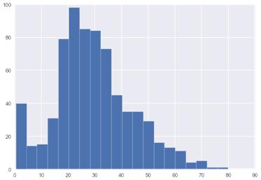
Histogram
# passengers
age
10 Bins
# passengers
age
20 Bins

Slide 40
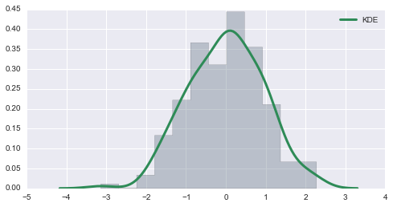
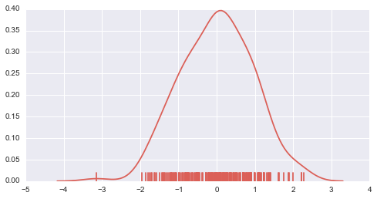
Density Plots
http://web.stanford.edu/~mwaskom/software/seaborn/tutorial/plotting_distributions.html

Slide 41
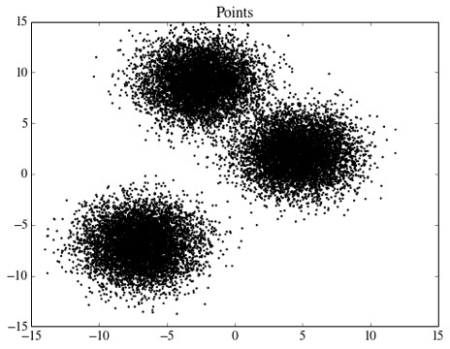

Heat Maps
2D Density Plots

Slide 42

Box Plots
aka Box-and-Whisker Plot
Wikipedia

Slide 43
Questions
?

